Slide 1
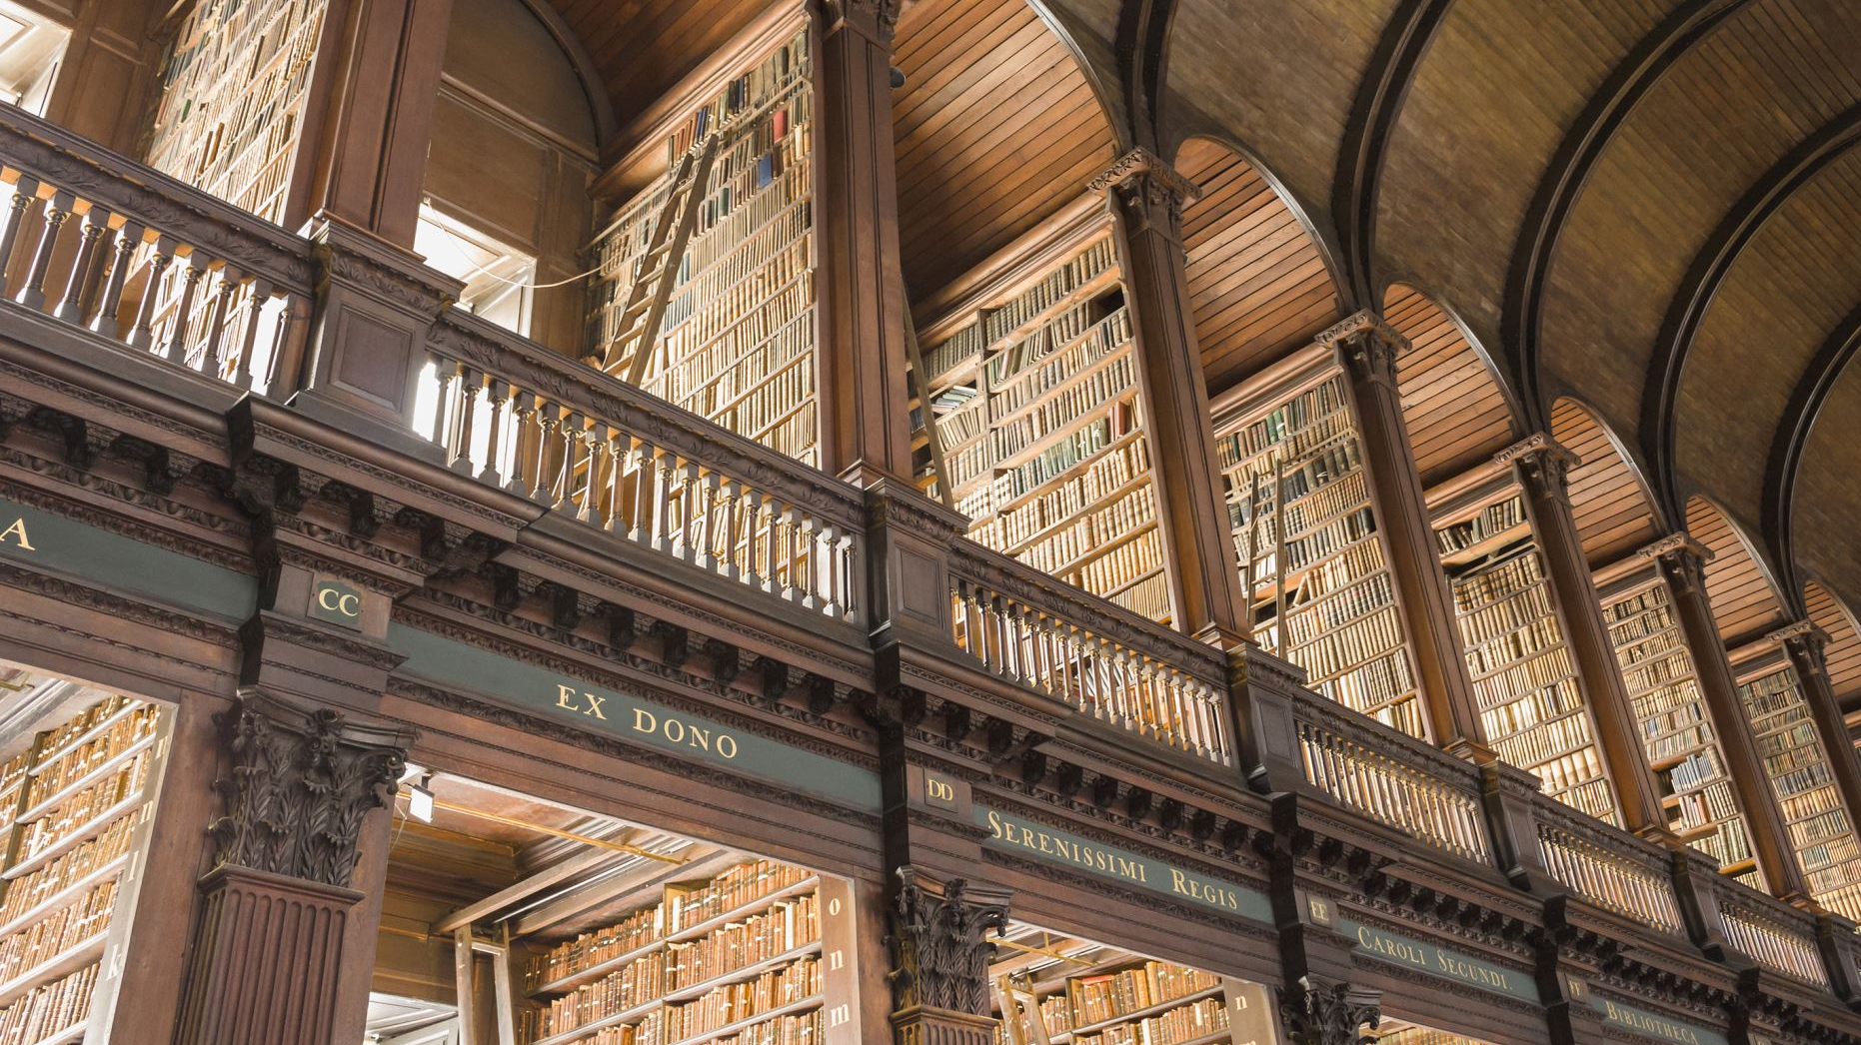
Foundation Project
Ruth Eskinder

Slide 2
The Memory library
Basic version of the Goodreads website
What does it do?
Catalogs books that you add to the 5 shelves: Ebook, Physical, Read, Currently Reading, Want To Read
What kind of data is being used?
All of the datatypes are varchar
ASIN, ISBN-13, Title, Series, Author, Rating, etc
How would this project be useful?
Users can use this project to have their own personal Goodreads in their MySQL Database or their personal computer instead of on the internet

Slide 3
Tech stack
Git/GitHub
VS Code
Python3
MySQL Connector, Maskpass, Tabulate, Colorama

Slide 4
Project demonstration

